Slide 1
Natural Language processing Email Classification
Mr. Parth Mane
Ms. Siddhi Bakliwal

Slide 2
Business problem
Inappropriate emails tend to demotivate and spoil the positive environment that would lead to more attrition rate and low productivity
Inappropriate emails could be in form of bullying, racism, sexual favoritism and hate in the gender or culture
In today's world, so dominated by email, no organization is immune to these hate emails

Slide 3
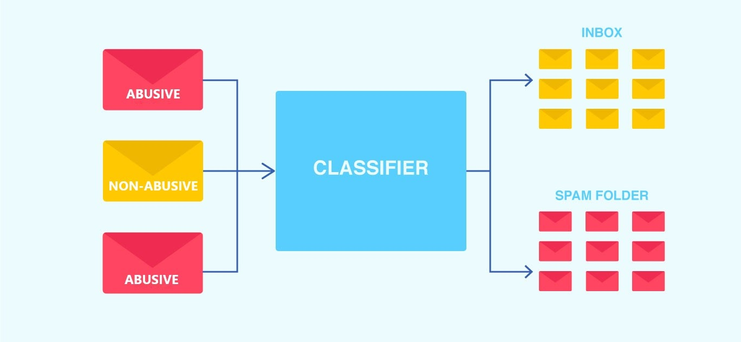
objective
The goal of the project is to identify such emails on a given day based on the above inappropriate content and classify them as Abusive or Non-Abusive emails.

Slide 4
Project blueprint
Importing Libraries and Dataset
Data Visualization
Exploratory Data Analysis
Feature Extraction
Model Building
Model Testing
Deployment

Slide 5
Data Visualization
Univariate Analysis
Bivariate Analysis
Multivariate Analysis

Slide 6
Exploratory Data Analysis ( EDA )
Null Values
Duplicate Values
Value Counts
Data Cleaning

Slide 7
Feature Extraction
Count Vectorizer
Term Frequency Inverse Vectorizer
N- gram vectorizer
Class Label Encoding

Slide 8
Models used for model building
Logistic Regression Classifier
Super Vector machine Classifier
Naïve Bayes Classifier
Decision Tree Classifier
Random Forest Classifier

Slide 9
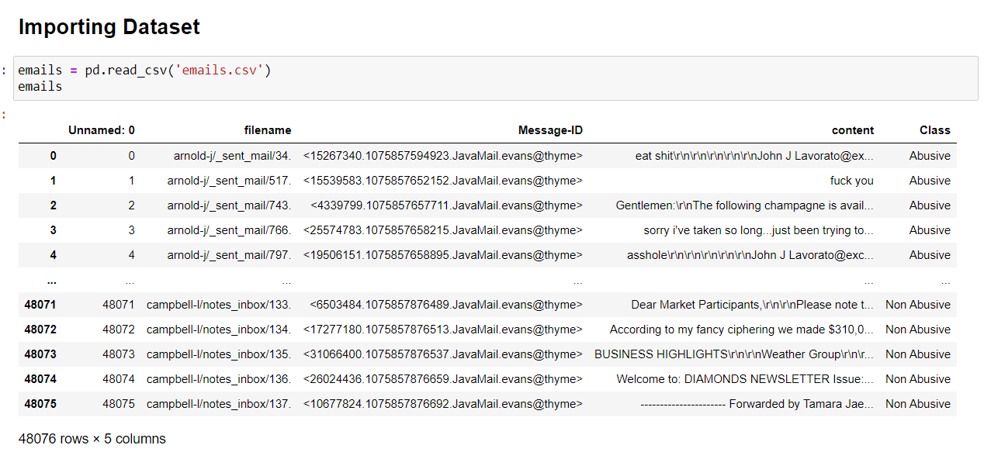
Dataset

Slide 10
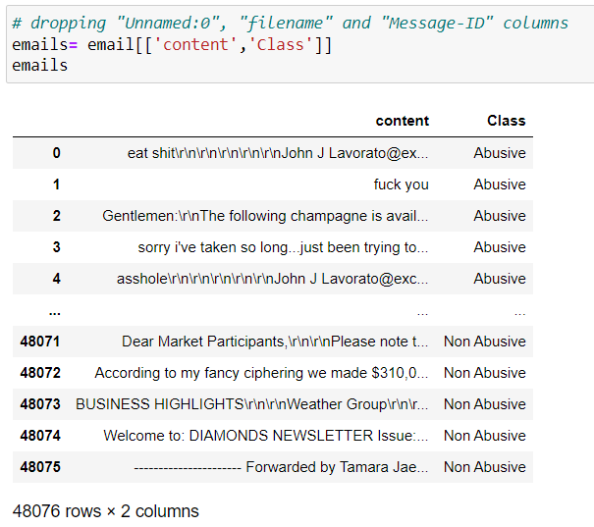
Data Preparation
We can drop the columns that have no significance over the objective of this project. So, we drop the columns named "Unnamed:0", "filename" and "Message-ID".

Slide 11
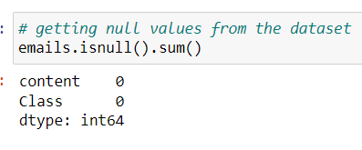
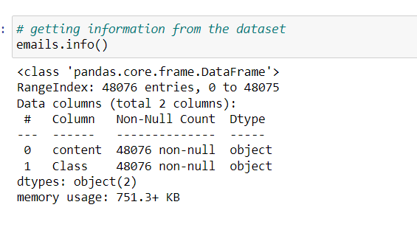
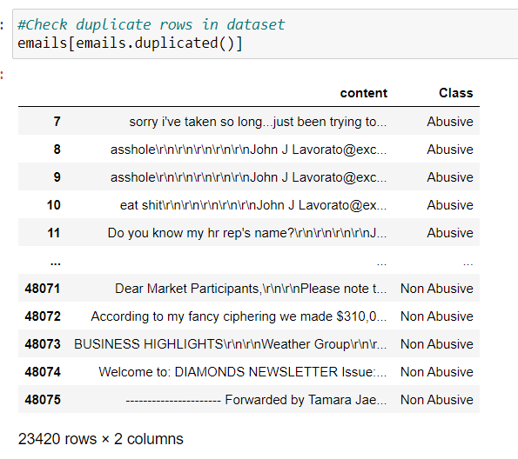
Exploratory Data Analysis
Null Values in the Data
Data Information
Duplicate Values / Rows

Slide 12
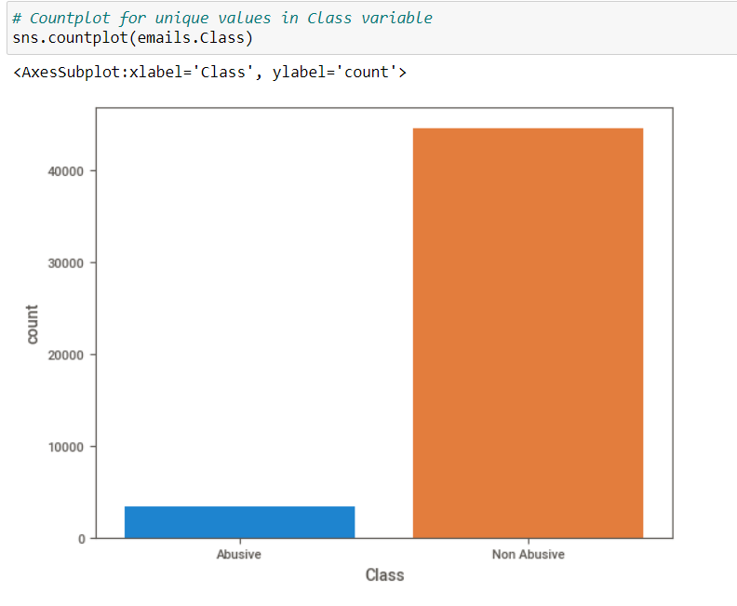
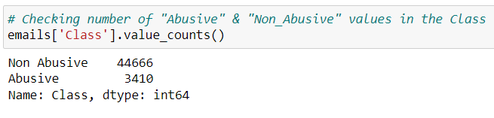
Count Plot
Class’s Value Counts

Slide 13
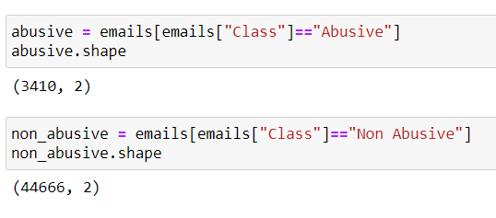
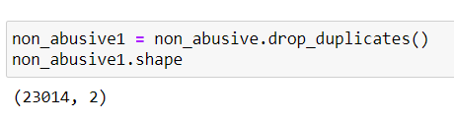
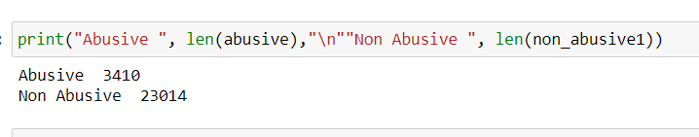
Splitting
Dropping Duplicates

Slide 14
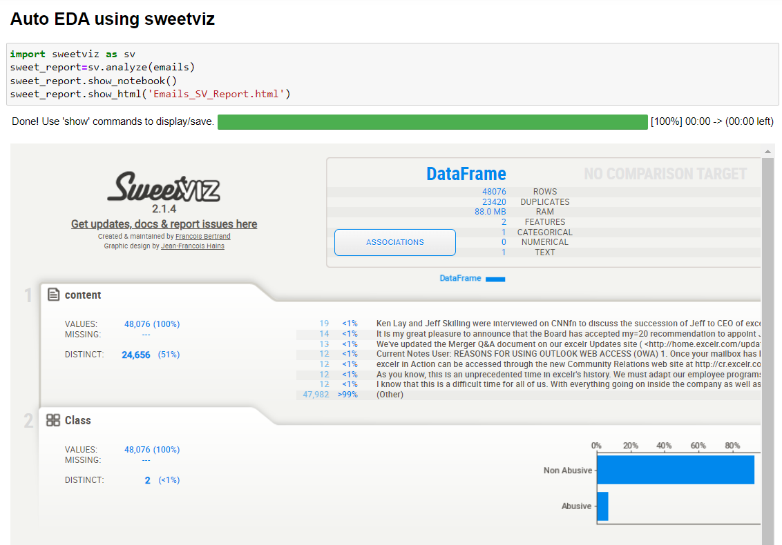
Auto EDA

Slide 15
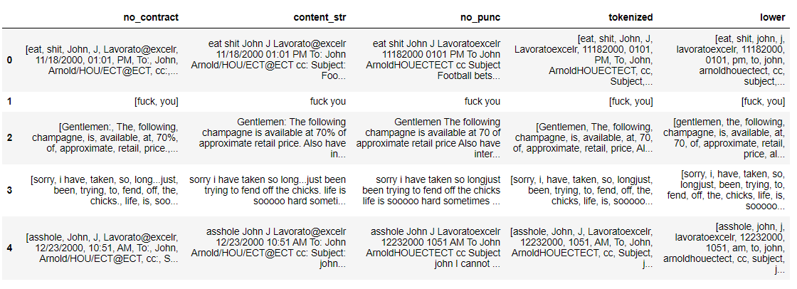
Text pre-processing
Contractions
Punctuations
Tokenize
Lower case

Slide 16
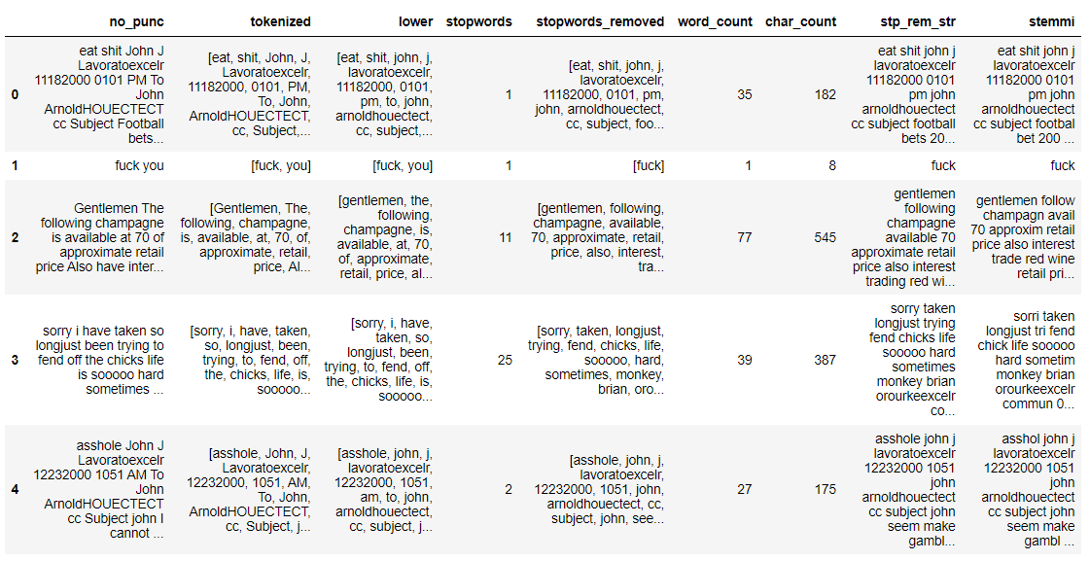
Text pre-processing
5. Stopwords
6. Stopwords
removal
7. Word count
8. Character count
9. Stammering

Slide 17
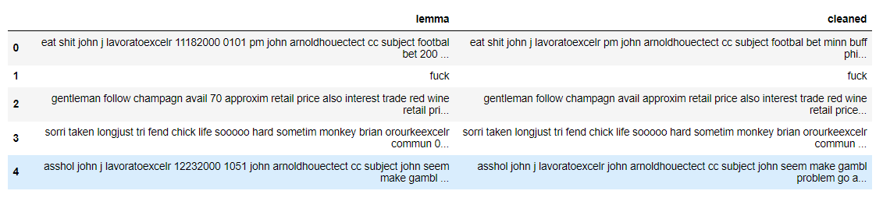
Text pre-processing
10. Lemmatization
11. Removing
numbers

Slide 18
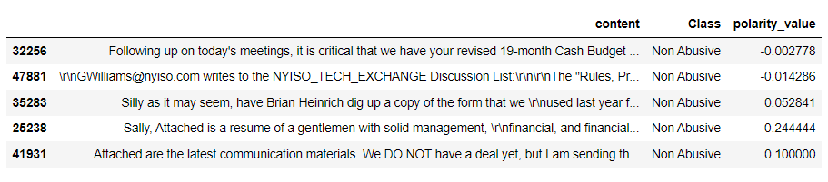
Sentiment Analysis

Slide 19
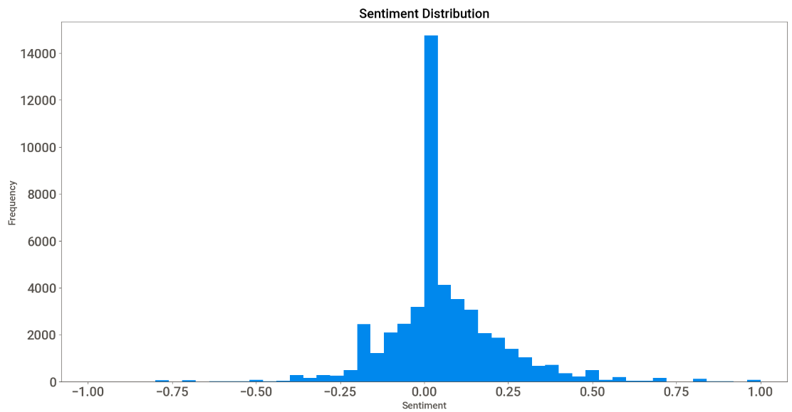
Data Visualization
Sentiment Popularity Score Histogram

Slide 20
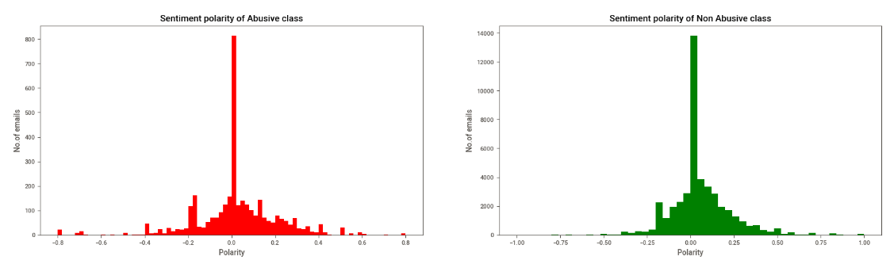

Slide 21
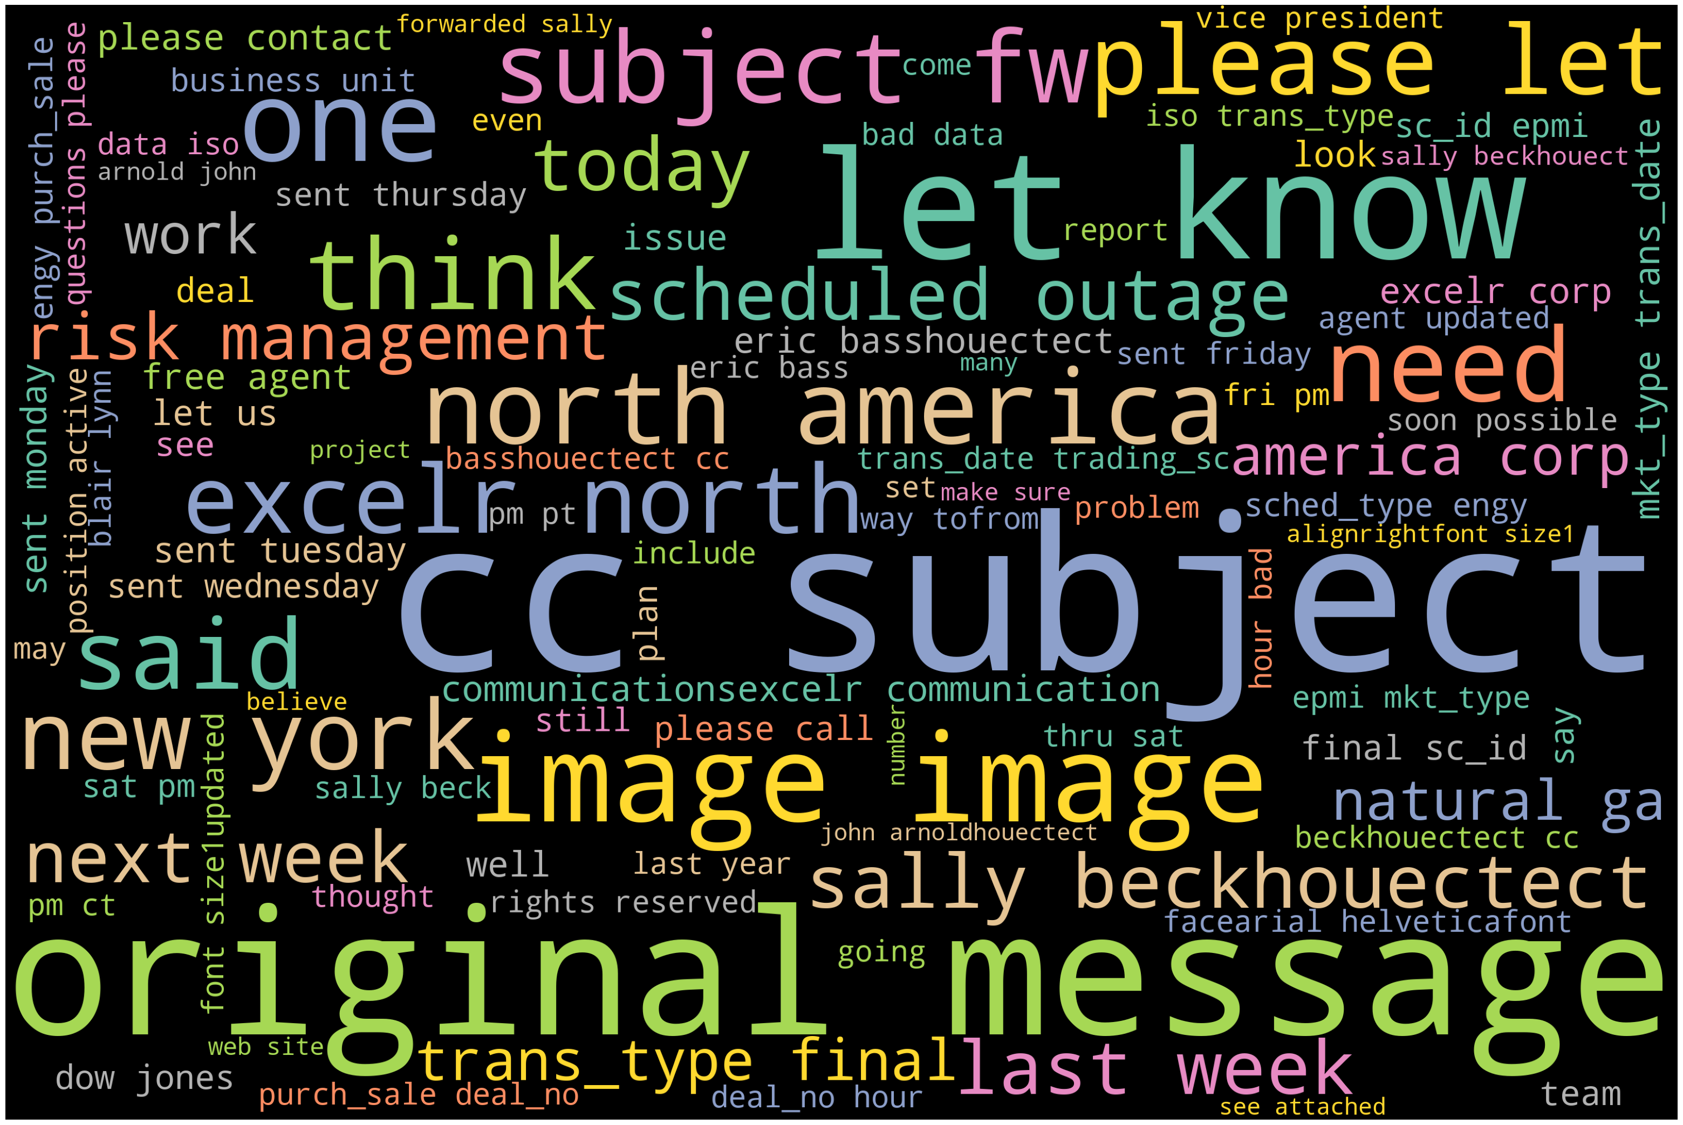
Word Cloud
For 100 most used words on the dataset

Slide 22
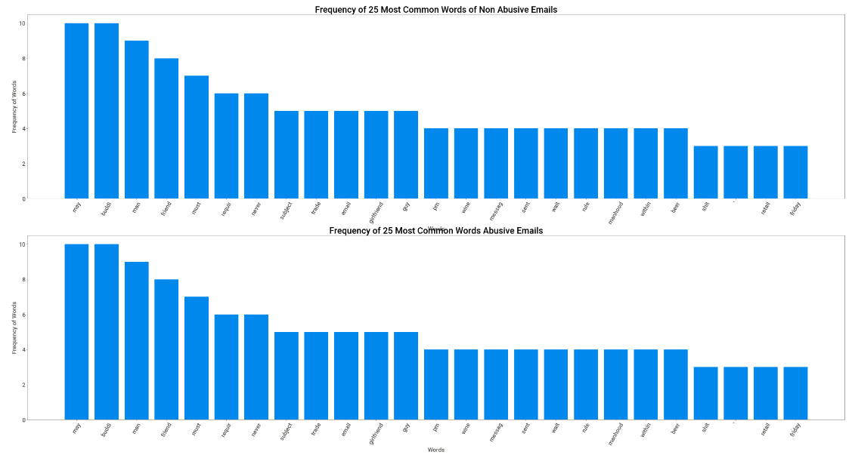

Slide 23
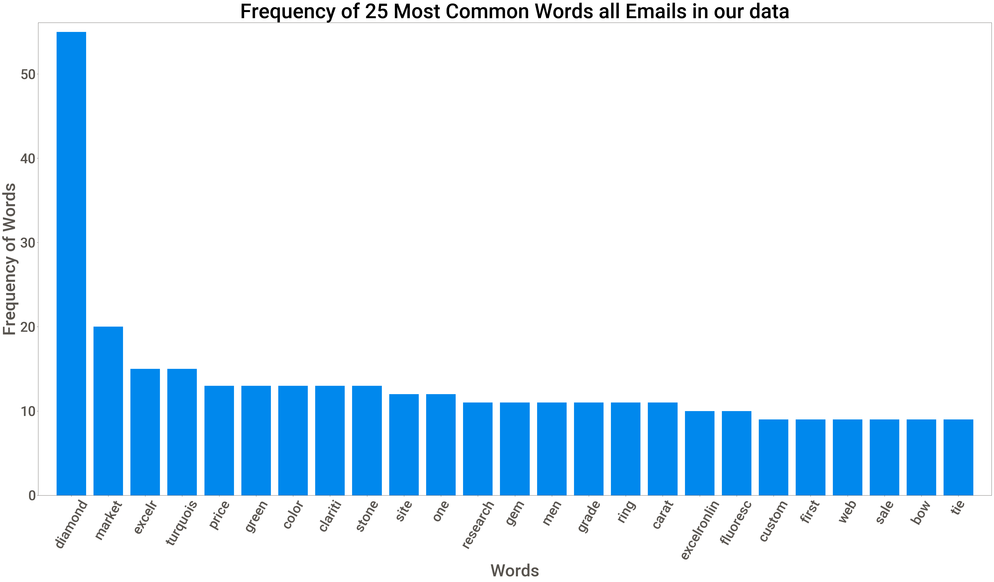

Slide 24
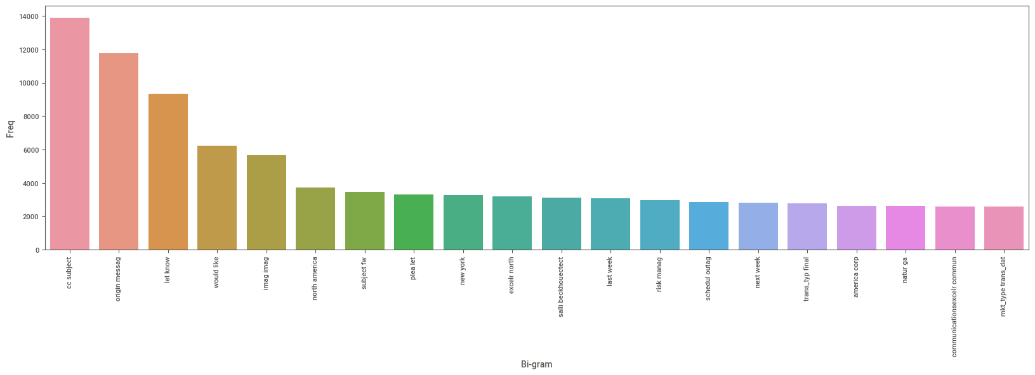
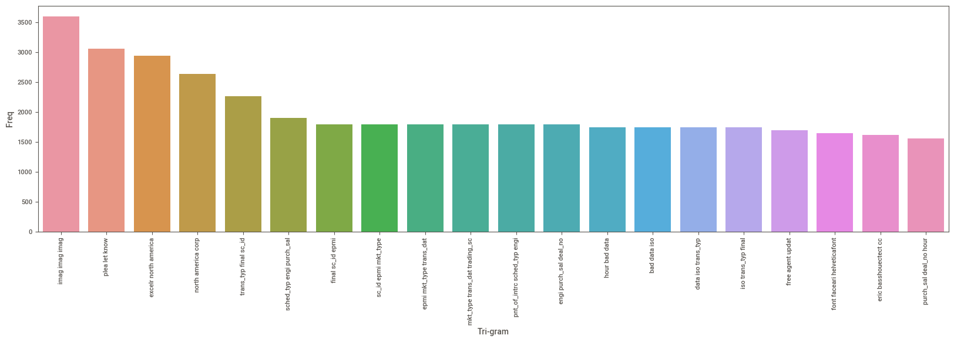
Bi- Gram Plot
Tri- Gram Plot

Slide 25
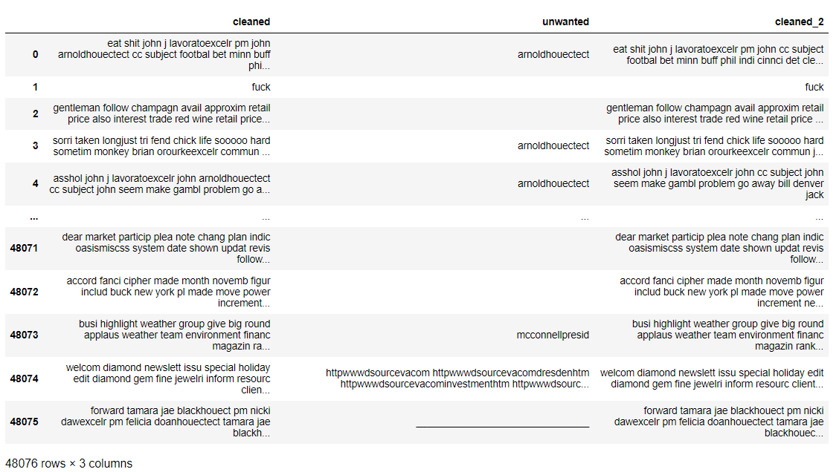
Cleaned Data

Slide 26
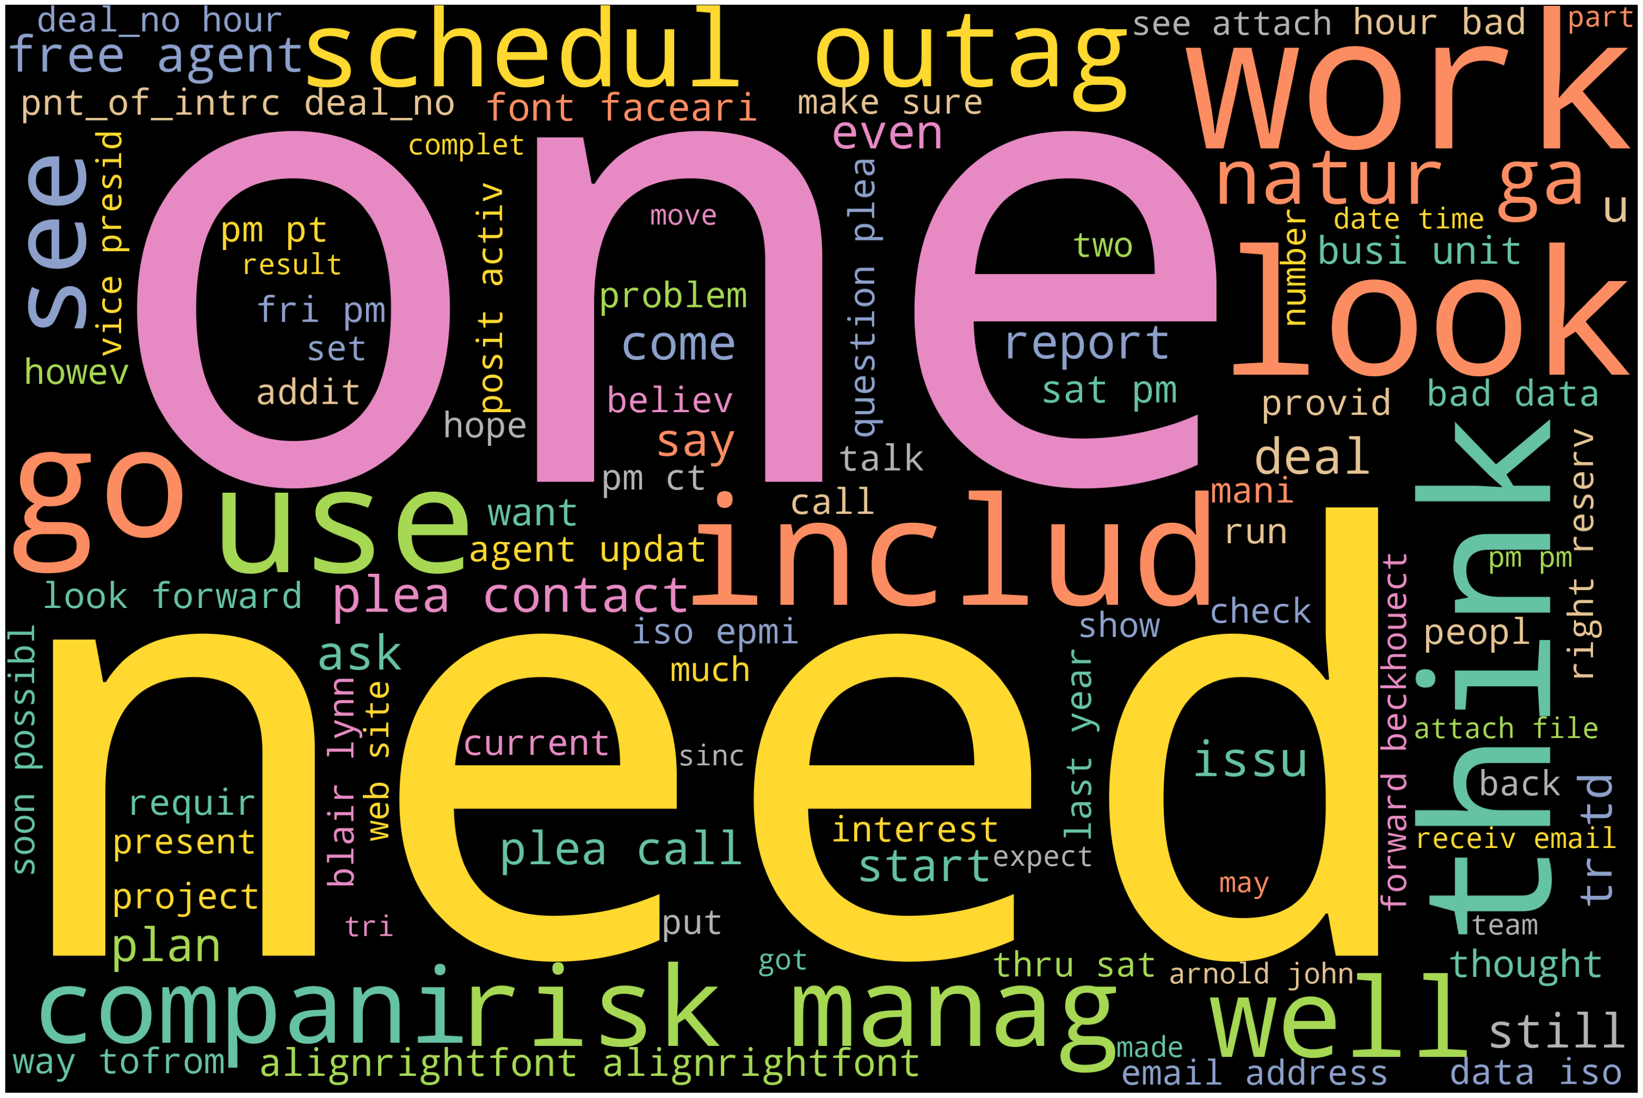
Word Cloud after cleaning data, that is after removing unwanted words

Slide 27
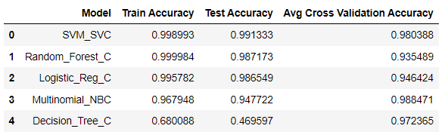
Model Building
Models used
Accuracy
Multinomial Naive Bayes Classifier Algorithm
Logistic Regression Classifier Algorithm
Decision Tree Classifier
Random Forest Classifier
Support Vector Machines Classifier Algorithm

Slide 28
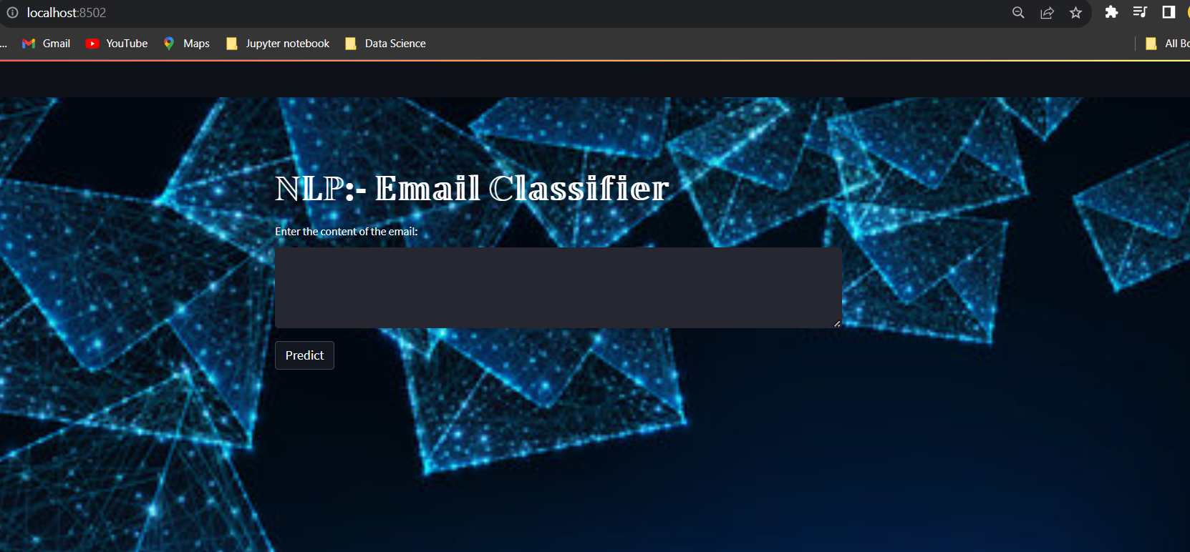
Model Deployment

Slide 29
THANK YOU
Parth Mane​
parthmane1999@gmail.com

